Slide 1
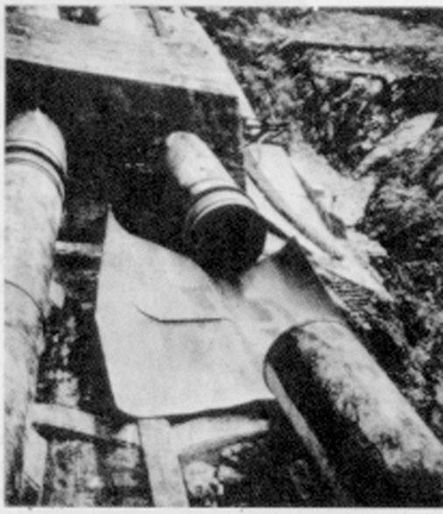
Hydraulic Transients
When the Steady-State design fails!

Slide 2
Hydraulic Transients: Overview
In all of our flow analysis we have assumed either _____ _____ operation or ________ ______ flow
What about rapidly varied flow?
How does flow from a faucet start?
How about flow startup in a large, long pipeline?
What happens if we suddenly stop the flow of water through a tunnel leading to a turbine?
steady state
gradually
varied

Slide 3
Hydraulic Transients
Unsteady Pipe Flow: time varying flow and pressure
Routine transients
change in valve settings
starting or stopping of pumps
changes in power demand for turbines
changes in reservoir elevation
turbine governor ‘hunting’
action of reciprocating pumps
lawn sprinkler
Catastrophic transients
unstable pump or turbine operation
pipe breaks

Slide 4
References
Chaudhry, M. H. 1987. Applied Hydraulic Transients. New York, Van Nostrand Reinhold Company.
Wylie, E. B. and V. L. Streeter. 1983. Fluid Transients. Ann Arbor, FEB Press.

Slide 5
Analysis of Transients
Gradually varied (“Lumped”) _________
conduit walls are assumed rigid
fluid assumed incompressible
flow is function of _____ only
Rapidly varied (“Distributed”) _________
fluid assumed slightly compressible
conduit walls may also be assumed to be elastic
flow is a function of time and ________
ODE
time
PDE
location

Slide 6
Establishment of Flow: Final Velocity
1
How long will it take?
g = 9.8 m/s²
H = 100 m
∑K = ____
f = 0.02
L = 1000 m
D = 1 m
H
EGL
1.5
HGL
V
2
L
0.5
K_{en}= ____
K_{exit}= ____
1.0
major
minor

Slide 7
Final Velocity
g = 9.8 m/s²
H = 100 m
∑ K = 1.5
f = 0.02
L = 1000 m
D = 1 m
9.55 m/s
What would V be without losses? _____
44 m/s

Slide 8
Establishment of Flow: Initial Velocity
Navier Stokes?
before head loss becomes significant
10
9
8
g = 9.8 m/s²
H = 100 m
∑ K = 1.5
f = 0.02
L = 1000 m
D = 1 m
7
6
5
velocity (m/s)
4
3
2
1
0
0
5
10
15
20
25
30
time (s)

Slide 9
Flow Establishment: Full Solution
gravity
drag
________, ________

Slide 10
Flow Establishment: tanh!
V < V_{f}

Slide 11
Time to reach final velocity
Time to reach 0.9V_{f} increases as:
L increases
H decreases
Head loss decreases

Slide 12
Flow Establishment
g = 9.8 m/s²
H = 100 m
K = 1.5
f = 0.02
L = 1000 m
D = 1 m
Was f constant?
10⁷

Slide 13
Household plumbing example
Have you observed the gradual increase in flow when you turn on the faucet at a sink?
50 psi - 350 kPa - 35 m of head
K = 10 (estimate based on significant losses in faucet)
f = 0.02
L = 5 m (distance to larger supply pipe where velocity change is less significant)
D = 0.5” - 0.013 m
time to reach 90% of final velocity?
No?
Good!
T_{0.9Vf} = 0.13 s

Slide 14
V > V_{f}?
If V₀=∞
Why does velocity approach final velocity so rapidly?

Slide 15
Lake Source Cooling Intake Schematic
Motor
Lake Water Surface
Steel Pipe
100 m
?
Plastic Pipe
3100 m
Intake Pipe, with flow Q and cross sectional area A_{pipe}
1 m
Pump inlet
length of intake pipeline is 3200 m
Wet Pit, with plan view area A_{tank}
What happens during startup?
What happens if pump is turned off?

Slide 16
Transient with varying driving force
Q
where
Lake elevation - wet pit water level
H = ______________________________
f(Q)
What is z=f(Q)?
Finite Difference Solution!
Is f constant?

Slide 17
Wet Pit Water Level and Flow Oscillations
2
4
Q
z
1.5
3
1
2
/s)
0.5
1
3
0
0
z (m)
Q (m
-0.5
-1
-1
-2
-1.5
-3
-2
-4
0
200
400
600
800
1000
1200
time (s)
constants
What is happening on the vertical lines?

Slide 18
Wet Pit with Area Equal to Pipe Area
Pipe collapse
Water Column Separation
Why is this unrealistic?

Slide 19
Overflow Weir at 1 m

Slide 20
Period of Oscillation: Frictionless Case
z = -H
z = 0 at lake surface
Wet pit mass balance

Slide 21
Period of Oscillations
plan view area of wet pit (m²) 24
pipeline length (m) 3170
inner diameter of pipe (m) 1.47
gravity (m/s²) 9.81
T = 424 s
Pendulum Period?

Slide 22
Transients
In previous example we assumed that the velocity was the same everywhere in the pipe
We did not consider compressibility of water or elasticity of the pipe
In the next example water compressibility and pipe elasticity will be central

Slide 23
Valve Closure in Pipeline
V
Sudden valve closure at t = 0 causes change in discharge at the valve
What will make the fluid slow down?____
Instantaneous change would require __________
Impossible to stop all the fluid instantaneously
↑p at valve
infinite force
What do you think happens?

Slide 24
Transients: Distributed System
Tools
Conservation of mass
Conservation of momentum
Conservation of energy
We’d like to know
pressure change
rigid walls
elastic walls
propagation speed of pressure wave
time history of transient

Slide 25
Pressure change due to velocity change
HGL
unsteady flow
steady flow
velocity
density
pressure

Slide 26
Momentum Equation
HGL
1
2
Neglect head loss!
Mass conservation
A₁ ≅ A₂
Δp = p₂ - p₁

Slide 27
Magnitude of Pressure Wave
1
2
increase
Decrease in V causes a(n) _______ in HGL.

Slide 28
Propagation Speed: Rigid Walls
Conservation of mass
Solve for ΔV

Slide 29
Propagation Speed: Rigid Walls
momentum
mass
Need a relationship between pressure and density!

Slide 30
Propagation Speed: Rigid Walls
definition of bulk modulus of elasticity
Example:
Find the speed of a pressure wave in a water pipeline assuming rigid walls.
(for water)
speed of sound in water

Slide 31
Propagation Speed: Elastic Walls
D
Additional parameters
D = diameter of pipe
t = thickness of thin walled pipe
E = bulk modulus of elasticity for pipe
effect of water compressibility
effect of pipe elasticity

Slide 32
Propagation Speed: Elastic Walls
Example: How long does it take for a pressure wave to travel 500 m after a rapid valve closure in a 1 m diameter, 1 cm wall thickness, steel pipeline? The initial flow velocity was 5 m/s.
E for steel is 200 GPa
What is the increase in pressure?
solution

Slide 33
Time History of Hydraulic Transients: Function of ...
Time history of valve operation (or other control device)
Pipeline characteristics
diameter, thickness, and modulus of elasticity
length of pipeline
frictional characteristics
tend to decrease magnitude of pressure wave
Presence and location of other control devices
pressure relief valves
surge tanks
reservoirs

Slide 34
Time History of Hydraulic Transients
1
3
ΔH
ΔH
V=V_{o}
V=0
V= -V_{o}
V=0
a
a
L
L
2
ΔH
4
V=0
V= -V_{o}
L
L

Slide 35
Time History of Hydraulic Transients
5
ΔH
7
ΔH
V= -V_{o}
V=V_{o}
V=0
V=0
a
a
L
L
6
8
ΔH
V=0
V= V_{o}
L
L

Slide 36
Pressure variation over time
ΔH
Pressure head
reservoir level
Neglecting head loss!
time
Pressure variation at valve: velocity head and friction losses neglected
Real traces

Slide 37
Lumped vs. Distributed
lumped
For _______ system
pressure fluctuation period
T = __________________________
For LSC wet pit
Τ = 424 s
= 4*3170 m/1400 m/s = ____
9.1 s
What would it take to get a transient with a period of 9 s in Lake Source Cooling? ____________
Fast valve

Slide 38
Methods of Controlling Transients
Valve operation
limit operation to slow changes
if rapid shutoff is necessary consider diverting the flow and then shutting it off slowly
Surge tank
acts like a reservoir closer to the flow control point
Pressure relief valve
automatically opens and diverts some of the flow when a set pressure is exceeded

Slide 39
Surge Tanks
Reservoir
Surge tank
Tunnel/Pipeline
Reduces amplitude of pressure fluctuations in ________ by reflecting incoming pressure waves
Decreases cycle time of pressure wave in the penstock
Start-up/shut-down time for turbine can be reduced (better response to load changes)
Penstock
tunnel
T
Tail water
Surge tanks

Slide 40
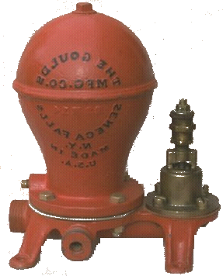
Use of Hydraulic Transients
There is an old technology that used hydraulic transients to lift water from a stream to a higher elevation. The device was called a “Ram Pump”and it made a rhythmic clacking noise.
How did it work?
High pressure pipe
Source pipe
Stream
Ram Pump

Slide 41
Minimum valve closure time
How would you stop a pipeline full of water in the minimum time possible without bursting the pipe?

Slide 42
Simplify: no head loss and hold pressure constant
Integrate from 0 to t and from Q to 0 (changes sign)

Slide 43
Back to Ram Pump: Pump Phase
Coordinate system?
P₁ = _____
P₂ = _____
z₂-z₁ = ___
0
-z₁
High pressure pipe
z₃
Source pipe
z
Stream
z₁

Slide 44
Reflections
What is the initial head loss term if the pump stage begins after steady state flow has been reached? _____
What is ?_____
What is when V approaches zero? ______
Where is most efficient pumping? ___________
How do you pump the most water? ______
z₁
z₃
Low V (low h_{l})
Maintain high V

Slide 45
Ram: Optimal Operation
What is the theoretical maximum ratio of pumped water to wasted water?
Rate of decrease in PE of wasted water equals rate of increase in PE of pumped water

Slide 46
High Q and Low loses?
Acceleration
Insignificant head loss
Deceleration (pumping)
Keep V high for max Q

Slide 47
Cycle times
Change in velocities must match

Slide 48
Summary (exercise)
When designing systems, pay attention to startup/shutdown
Design systems so that high pressure waves never occur
High pressure waves are reflected at reservoirs or surge tanks

Slide 49
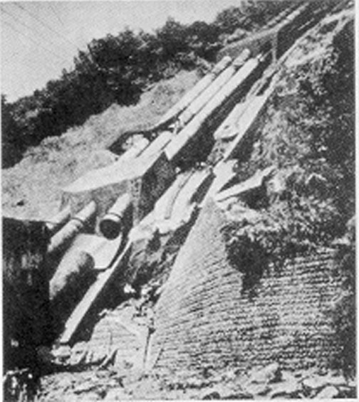
Burst section of Penstock: Oigawa Power Station, Japan
Chaudhry page 17

Slide 50
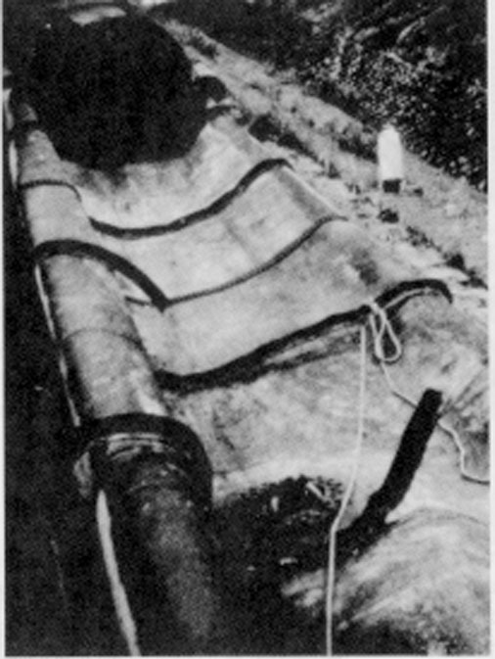
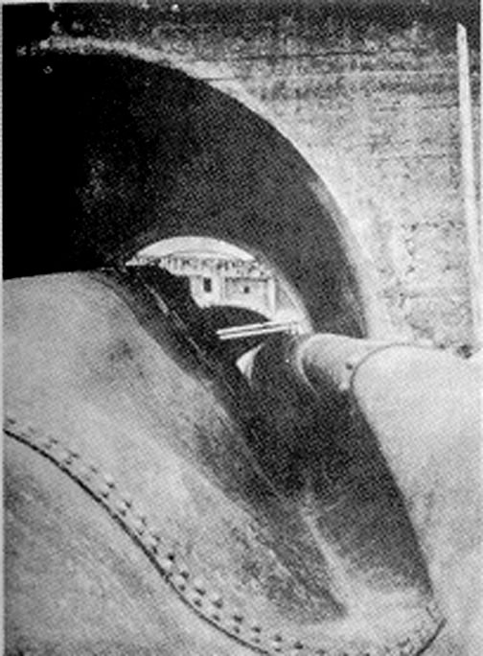
Collapsed section of Penstock: Oigawa Power Station, Japan
Chaudhry page 18

Slide 51
Values for Wet Pit Analysis
Flow rate before pump failure (m³/s) 2
plan view area of wet pit (m²) 24
pipeline length (m) 3170
inner diameter of pipe (m) 1.47
elevation of outflow weir (m) 10
time interval to plot (s) 1000
pipe roughness (m) 0.001
density (kg/m³) 1000
dynamic viscosity (Ns/m²) 1.00E-03
gravity (m/s²) 9.81

Slide 52
Pressure wave velocity: Elastic Pipeline
E = 200 GPa
D = 1 m
t = 1 cm
0.5 s to travel 500 m

Slide 53
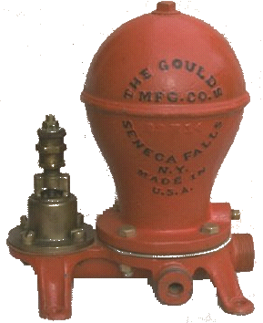
Ram Pump
Air Chamber
Rapid valve
Water inlet

Slide 54
Ram pump
H₂
High pressure pipe
Source pipe
H₁
Stream
Ram Pump

Slide 55
Ram animation
Notes:
http://schou.dk/animation/

Slide 56
Ram Pump
Time to establish flow

Slide 57
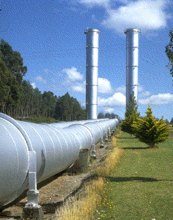
Surge Tanks

Slide 58
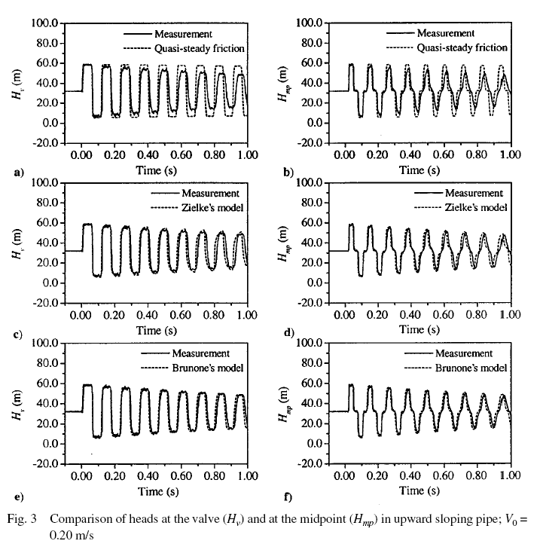
Real pressure traces
At valve
At midpoint
Notes:
http://www.iahr.org/publications/assets/jhr39-3/developments.pdf

